Slide 1


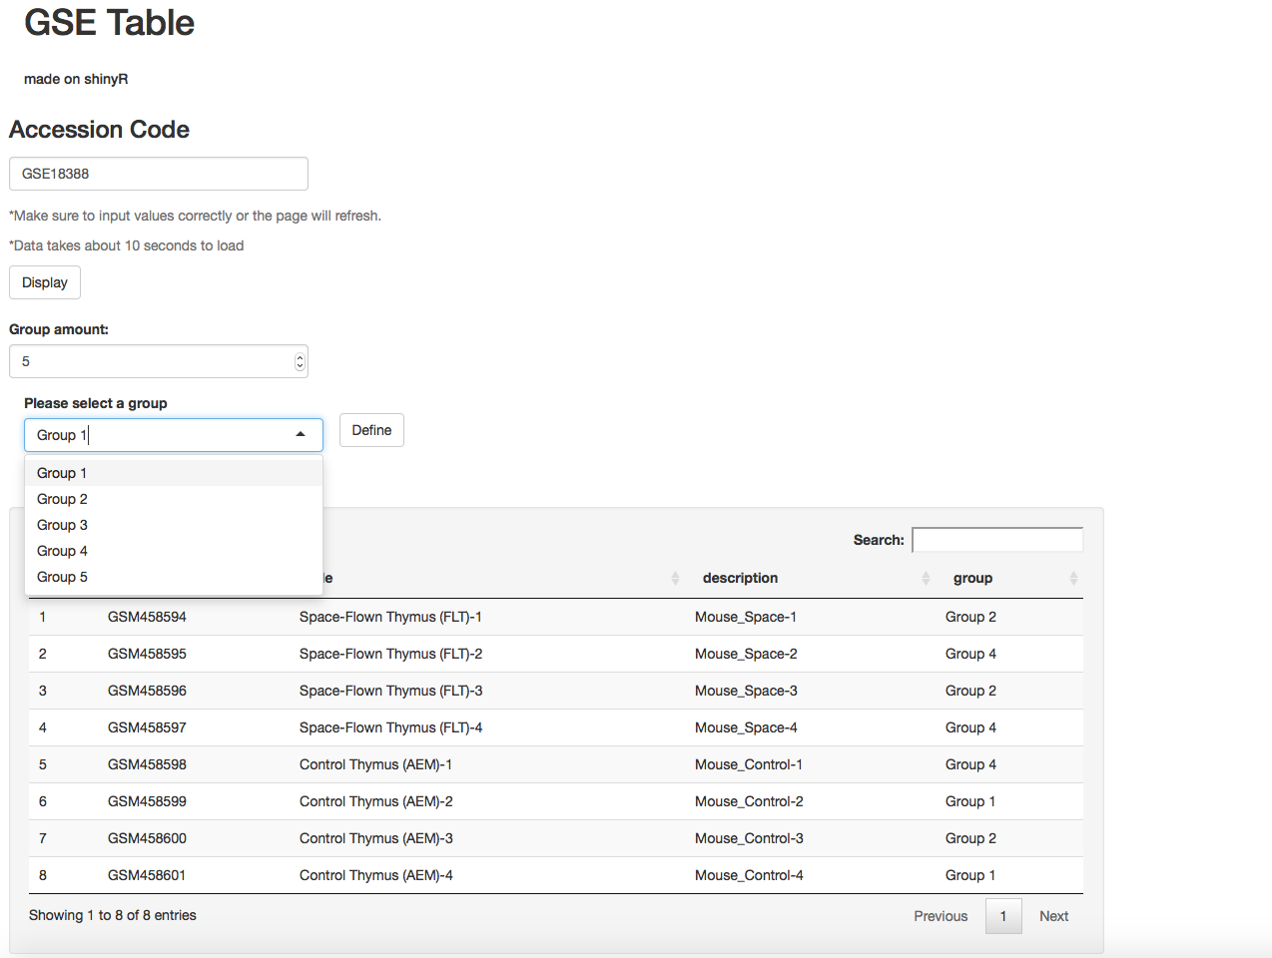


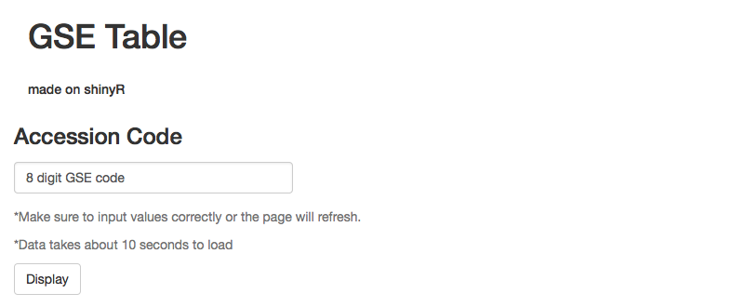
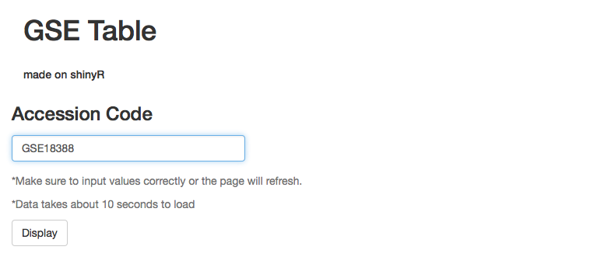
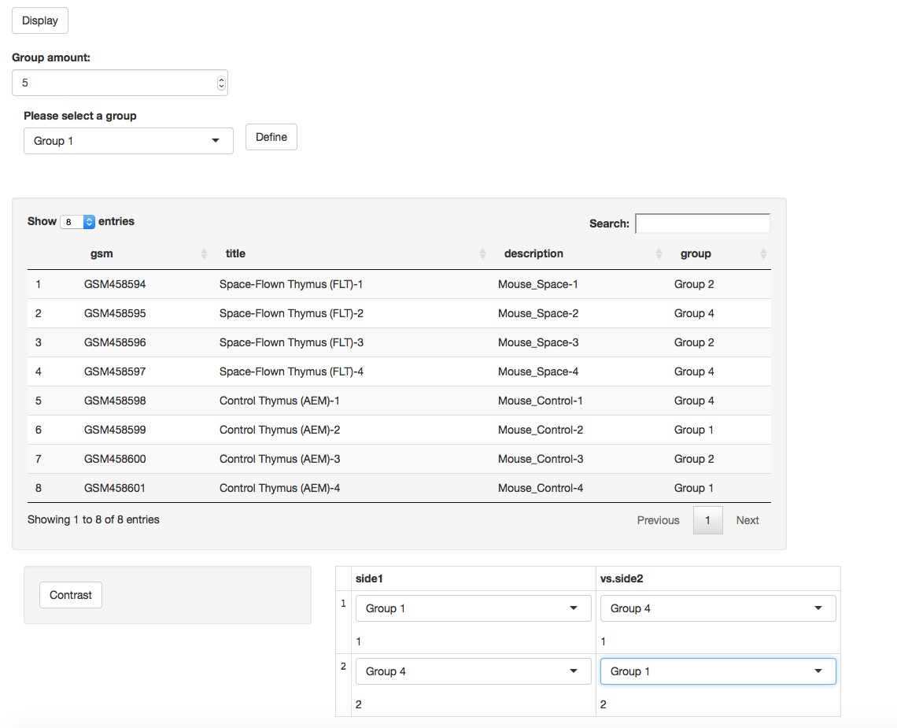
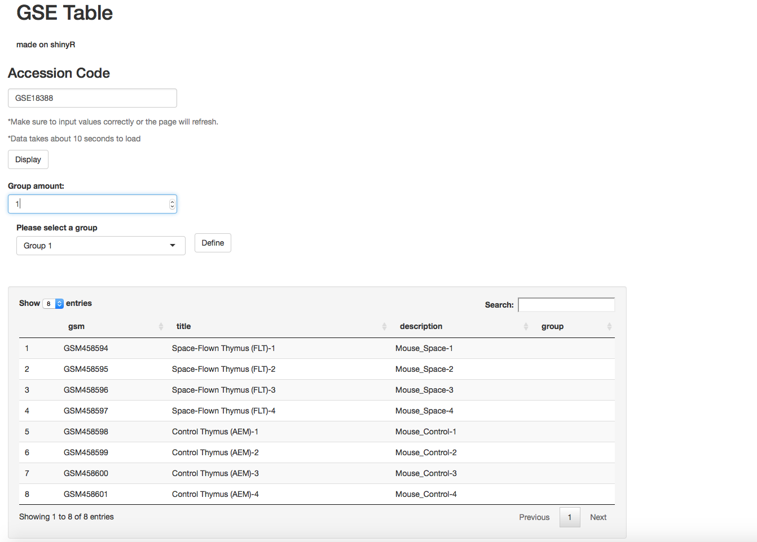
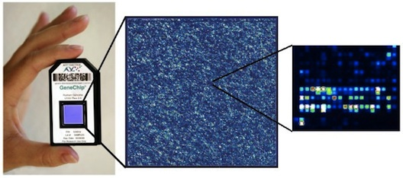
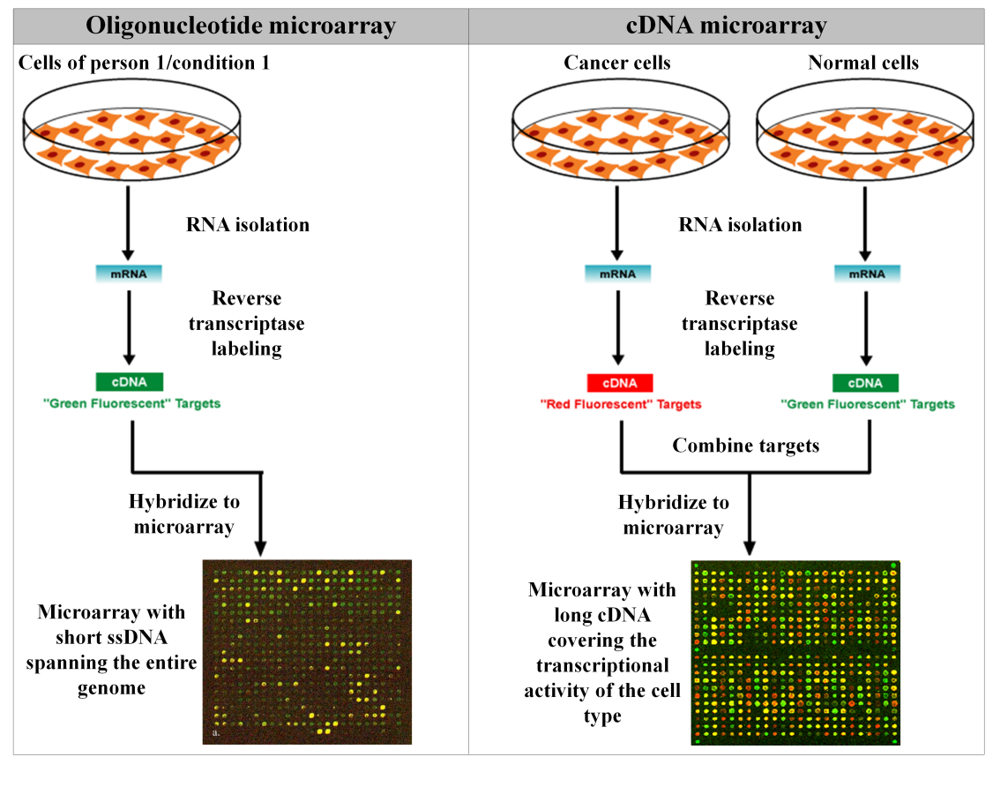
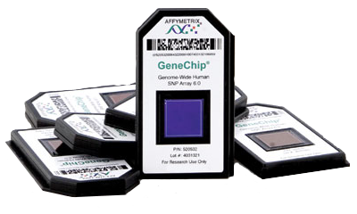
Development of a Microarray Data Analysis Web Application Using Shiny
￼
Matthew Go, Margaret Cam, Fathi Elluomi
INTRODUCTION
Microarray data supplied by practitioners and researchers from all departments is constantly being uploaded into local servers, like the one the NCBI (National Cancer for Biotechnology Information) provides for the NIH. However, the application used to display the list of thousands of results is limited in that it cannot pull from a more universal or public medical archive. In other words, data stored and analyzed is exclusive to the NIH staff.
Our application focuses on reaching a much wider audience so that progress and information from all across the country can be uploaded and thoroughly read as the NCBI server does. Using the computer language R and the RStudio software, we were able to exercise its “Shiny” package to create and design a functional interface, as well as making it look cleaner and simpler to use.
BACKGROUND
What are microarrays?
Microarrays are plates, usually made of an impermeable surface like glass or silicon, that hold thousands of sets of specific strands of DNA. To map which genes are active and which are suppressed, cultured cells from both healthy and malignant tissue are separated from their RNA and are then transcribed under an RNA polymerase to make a complementary form of DNA or cDNA. Once both sets of cDNA are successfully formed, they are dyed to be able to distinguish their separate gene expressions. The cDNA are then pipetted onto the microarray and placed into a reading machine. Spots of red, green, and yellow soon appear on the plate. After further analysis, the red markers indicate the genes greatly enhanced under malignant influence, the green display the ones healthy cells continue to express while cancer cells choose to hide, and yellow are patterns that both malignant and healthy DNA express. Now the yellow markers usually conclude that while these genes are active, they are mostly likely defected towards their usual means. This helps to see which DNA sequences are mutated or altered and which approach to take to reverse their effects or regulate the tumors behavior.
METHODS & RESULTS
This application was created using R version 3.3.0 and Rstudio version 0.99.451.
Packages “shiny”, “shinyjs”, “bioBase”, and “geoQuery” were installed to help run this template.
To demonstrate our application, sample number GSE18388 was taken from the NCBI database.
OVERVIEW
The purpose of this project was to create a prototype version of a new universally shared server in which metadata from microarray could be easily accessed and displayed.
Microarrays, especially in cancer research, help map the specific types of gene expressions certain oncogenes emit. This allows practitioners to be able to develop courses of medication to treat the mutated codon patterns within an individual’s DNA and RNA.
The GSE server sends protocols with the GEO2R and GEOQuery databases, where it derives all of its microarray information.
After uploading, defining, and contrasting data, the NCI Bioinformatics team will implement their R Studio made graphs and figures to accomedate this user interface and template.
CONCLUSIONS
This application made through the R Studio and the “Shiny” package is significant because this is the very first template that connects to microarray database on a public server. Most local servers are severely limited in its supply of data and are not accessible towards reaching a greater population.
Since the R Studio is mainly used for its professional layouts of displays and galleries, creating this template was vital towards making a new and improved program opposed to the original NCIB/NIH microarray application.
This will allow for further analysis of microarray data and a bigger network and community between doctors and researchers.
With the “Group Amount” and multiSelect functions, group assignment can easily be made.
The user can specify the range of numbers (1-10) and once labeled, samples are easily distinguishable.
Every microarray platform uploaded and submitted is labeled with a GSE (Genomic Series) number. Each number is unique so that researchers will be able to pull distinguished data from the server.
For our demo, we used the sample GSE18388 to exercise the application’s ability to display results.
This sample studies the thymus lobes from two sets of mice and the alterations made in gene expressions from stress regulation.
One is space-flown in a shuttle while the control is left on the ground.
ACKNOWLEDGEMENTS
First and foremost, thank you to Dr. Maggie Cam for giving me this project and amazing opportunity to be able to spend my summer across the country (from California) in the NCI department of the NIH. I am truly lucky to have gotten you as a preceptor.
Thank you to my main mentors and my friends, Fathi Elluomi and Bong-Hyun, who both were always more than happy to spend the time helping me learn the R Studio program and had the patience to explain the complexities and usages of microarrays.
http://www.stemcore.ca
BIBLIOGRAPHY
"Gallery." Shiny -. N.p., n.d. Web. 27 July 2016.
"Rstudio/shiny." GitHub. N.p., n.d. Web. 27 July 2016.
"R Shiny Different Output between RenderTable and RenderDataTable." - Stack Overflow. N.p., n.d. Web. 27 July 2016.
The contrast box allows for setting up different comparisons between GSMs of microarrays.
This allows the data selected and displayed in forms of graphs, heat maps, and standard deviations to be more personal regarding what is being analyzed.
Each GSE number marking the microarrays is exclusively printed on an affymetrix chip. Any other type of microarray currently is incompatible with our program since the affymetrix offers a wide platform that is more popularly distributed. It allows for higher value genotyping of complex diseases that effectively labels cRNA fragments and is commonly used in cancer variants.
The server then relays information back to the user-interface after the “Display” button is hit and a table of GSM tagged samples returns, each specifying the results of microarray data for each subject.
To differentiate or display contrast between groups of subjects, the “Group Amount” numericInput and selectInput both control the amount and labeling of desired groups.
CONTACT
Email: matthewgo1003@gmail.com
https://en.wikipedia.org

